Slide 1
Company insights
Part 2: Predicting customer buying behaviour
Date – 12/03/2022

Slide 2
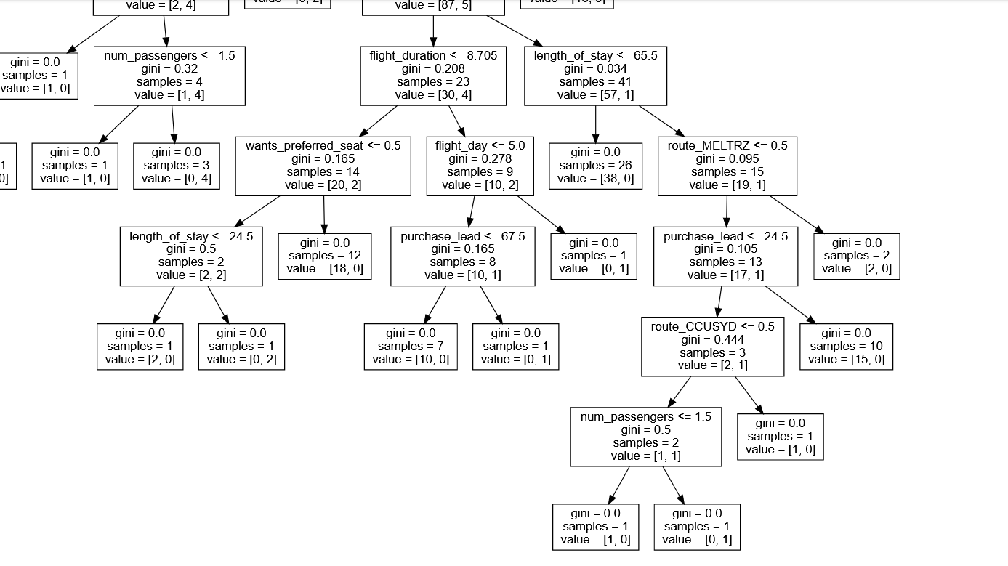
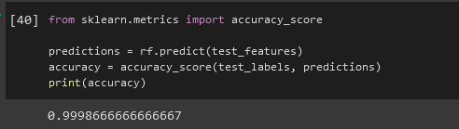
Summary

